Slide 1
Internet Security (CI6240)
Week 5 – Public Key Cryptography
Dr Martin Tunnicliffe
M.J.Tunnicliffe@kingston.ac.uk
Dr Eckhard Pfluegel
E.Pfluegel@kingston.ac.uk

Slide 2
Teaching Block 1
Introduction
Mathematical Primer
Classical Cryptography
Digital Symmetric Ciphers
Public Key Cryptography
(Reading Week)
Cryptographic Hash Functions
Networks and Network-Based Attacks
Firewalls and Secure Architectures
Cryptography on the Internet
In-Class Test 1
TB1 Wrap-Up

Slide 3
Upcoming Workshop Schedule
Week Beginning | Workshop Topic
26 September | Introduction to Deterlab
3 October | Mathematics
10 October | Classical Ciphers
17 October | Simplified DES
24 October | The RSA Cipher Algorithm (Today’s Workshop)
31 October | (Reading Week – No Workshop)
7 November | Getting Started with Deterlab
14 November | TCP Syn Flooding Experiment *
21 November
28 November | Permissions and Firewalls Experiment *
5 December
12 December | Prize Cryptography Competition
(DeterLab exercises in red. Portfolio exercises shown with a *)

Slide 4
Topics Covered
Symmetric and Asymmetric Cryptography
Confidentiality and Authentication
  Digital “signing”
Basics of the RSA Algorithm
  Required properties of RSA keys.
RSA Key Selection
  The Euler Totient Function and Euler’s Theorem
Using the RSA Algorithm
Cryptanalysis of RSA

Slide 5
1.
Symmetric and Asymmetric Cryptography

Slide 6
Symmetric Cryptography
Use same key for encryption and decryption
  Notation: C = E(K,P), P=D(K,C)
Problems:
  Keys need to be exchanged secretly
  A great many keys may need to be exchanged…
Example: Bob, Ann, Jim and Sue want to communicate confidentially with each other
  Bob’s messages to Ann may not be decrypted by Jim or Sue
  Ann’s messages to Sue may not be decrypted by Bob or Jim…Etc…

Slide 7




Symmetric Cryptography
CANNOT DECRYPT
JIM
BOB
CAN DECRYPT
CANNOT DECRYPT
CAN DECRYPT
PUBLIC MEDIUM (INSECURE)
SUE
ANN

Slide 8

Symmetric Cryptography
Attempt to decrypt: P′=D(K(ANN,BOB),C)
produces gibberish.
BOB
Decrypts:
P=D(K(ANN,JIM),C)
JIM
BOB’S KEY RING
K (BOB.ANN)
K (BOB,JIM)
K (BOB,SUE)
JIM’S KEY RING
K (BOB.JIM)
K (ANN.JIM)
K (JIM,SUE)
INTERCEPTED
MESSAGE
SUE
ANN
C=E(K(ANN,JIM),P)
ANN’S KEY RING
K (BOB,ANN)
K (ANN,JIM)
K (ANN,SUE)
SUE’S KEY RING
K (BOB,SUE)
K (JIM,SUE)
K (ANN,SUE)
INTERCEPTED
MESSAGE
Ann sends a secret message P to Jim, which is not to be read by either Bob or Sue
Attempt to decrypt: P′=D(K(ANN,SUE),C)
produces gibberish.
Six secret keys must be exchanged in order for this system to work

Slide 9
Symmetric Cryptography
n-user system requires n(n-1)/2 keys:
Need a secure method of transferring all these keys
No. of users n |  | # Keys Needed
2 | 2(2-1)/2 | 1
3 | 3(3-1)/2 | 3
4 | 4(4-1)/2 | 6
5 | 5(5-1)/2 | 10
10 | 10(10-1)/2 | 45
50 | 50(50-1)/2 | 1225
100 | 100(100-1)/2 | 4950

Slide 10
Asymmetric Cryptography
Also called “Public Key Cryptography”
Encryption/decryption requires a pair of keys:
  One key to encrypt
  The other to decrypt
First proposed in 1967 by Whitfield Diffie and Martin Hellman of Stanford University
  Paper “New Directions in Cryptography”, IEEE Transactions on Information Theory, IT-22(6).
  You can download the original paper from http://www-ee.stanford.edu/~hellman/publications/24.pdf

Slide 11
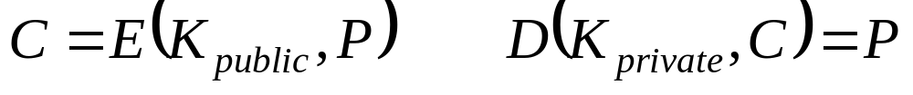
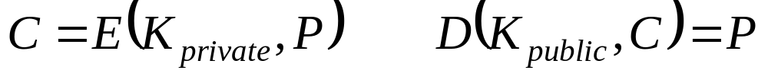
Public Key Cryptography
Keys are created together in pairs:
Key Generator
Algorithm
PUBLIC KEY K_{public}
PRIVATE KEY
K_{private}
Properties of the two keys:
  Messages encrypted using PUBLIC KEY are decrypted by PRIVATE KEY.
  Messages encrypted using PRIVATE KEY are decrypted by PUBLIC KEY.
Notation:

Slide 12
Key Generation
Private key cannot (feasibly) be inferred from the public key
  In most systems it can be done, but would require excessive computing power
    This is called “semantic” security
  However, the key pair must be generated without using excessive computing power
    It must be hard for the enemy but easy for us
Requires one-way function
  A kind of mathematical “trap door”

Slide 13


Trap Door Function
Difficult
The attacker needs to perform the one-way function in reverse in order to recover the random information and re-calculate the private key.
Easy
PUBLIC KEY
Randomly Generated Information
ONE WAY FUNCTION
PRIVATE KEY
Notes:
The door of the raccoon-trap can be passed easily in one direction, but not without great difficulty in the other. Similarly the keys can be calculated easily from the randomly generated data, but it would be very difficult to calculate the random data based only on one of the keys.

Slide 14

Public Key Cryptography
BOB
(ANYONE ELSE)
JIM
BOB’S KEY RING
K_{private}(BOB)
K_{public}(ANN)
JIM’S KEY RING
K_{private}(JIM)
K_{public}(ANN)
SUE
ANN’S KEY RING
K_{private}(ANN)
ANN
SUE’S KEY RING
K_{private}(SUE)
K_{public}(ANN)
K_{public}(ANN)
Ann makes her public key accessible to Jim, Bob and Sue (and to anyone else who wants it)
Only four non-secret keys must be exchanged for this system to work

Slide 15
Public Key Cryptography
Attempt to decrypt: P′=D(K_{private}(BOB),C)
produces gibberish.
BOB
Decrypts:
P=D(K_{private}(JIM),C)
JIM
BOB’S KEY RING
K_{private}(BOB)
K_{public}(ANN)
K_{public}(JIM)
K_{public}(SUE)
JIM’S KEY RING
K_{private}(JIM)
K_{public} (BOB)
K_{public} (ANN)
K_{public} (JIM)
INTERCEPTED
MESSAGE
SUE
ANN
C=E(K_{public}(JIM),P)
ANN’S KEY RING
K_{private}(ANN)
K_{public}(BOB)
K_{public}(JIM)
K_{public}(SUE)
SUE’S KEY RING
K_{private}(SUE)
K_{public} (BOB)
K_{public} (JIM)
K_{public} (ANN)
INTERCEPTED
MESSAGE
Ann sends a secret message P to Jim, which is not to be read by either Bob or Sue
Attempt to decrypt: P′=D(K_{private}(SUE),C)
produces gibberish.
Only four non-secret keys must be exchanged for this system to work

Slide 16
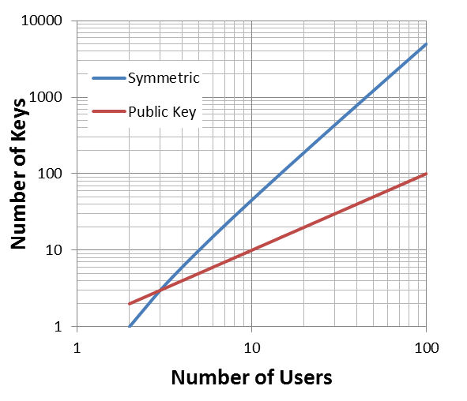
Public Key Cryptography
n-user system requires n keys:
None of these keys needs to be transferred securely
No. of users n | # Symmetric Keys | # Public Keys
2 | 1 | 2
3 | 3 | 3
4 | 6 | 4
5 | 10 | 5
10 | 45 | 10
50 | 1225 | 50
100 | 4950 | 100
Notes:
It is only when there are just 2 users that the symmetric system requires fewer keys.

Slide 17
2.
Confidentiality and Authentication

Slide 18

Confidentiality
Alice
Public keys are freely exchanged across the network.
Bob
K_{PUB,A}
K_{PUB,B}
Pair
Pair
K_{PRIV,A}
X
K_{PRIV,B}
Private keys are never sent
When Alice sends to Bob, she encrypts her message using K_{PUB,B}
Only Bob can decrypt Alice’s message since only he has K_{PRIV,B}.
When Bob sends to Alice, he encrypts his message using K_{PUB,A}
Only Alice can decrypt Bob’s message since only she has K_{PRIV,A}.

Slide 19
Authentication
How can Alice send a message to Bob so that Bob can be sure message is from Alice?
  Alice uses her private key to encrypt message
  Send “digital signature” to Bob: C=E(k_{PRIV,A},P).
  Bob uses Alice’s public key to decrypt: P=E(k_{PUB,A},C).
  Successful decryption means the message must have come from Alice (since it must have been encrypted using her key).
Advantages:
  Authenticity: we can prove origin of message
  Integrity: any tampering with message will be detected
  Non-repudiation: Alice cannot claim that she hasn’t sent message

Slide 20
Authentication
Public key B
Private key B
Private key A
Encrypts
Decrypts
Public key A
Alice
Bob
Message
Sent
Message
Received
This does not make the messages secure but it proves where the messages came from.
If received message is anything other than gibberish it must have come from Alice!

Slide 21
Secrecy and Authentication
Not secret, since everybody knows Alice’s public key!
The two approaches can be combined:
  Alice first applies her private key (authentication)
  She then applies Bob’s public key on the result (secrecy)
  She sends to Bob: C=E(k_{PUB,B}, E(k_{PRIV,A}, P))
  Bob decrypts message using first his own private key and then Alice’s public key: P=D(k_{PUB,A}, D(k_{PRIV,B}, C))
  If the result is intelligible it must have come from Alice.
Encrypting with your own private ley is called “Digital Signing”
  We will return to digital signatures later
Notes:
You will probably have noticed that a few holes remain. How for example can a computer detect if an encrypted message is intelligible? And how does Bob know that the public key he thinks belongs to Alice really is from her? We will discuss these problems in the weeks to come.

Slide 22
3.
Basics of the RSA Algorithm

Slide 23
Public Key Algorithms
There are many public key algorithms
Some are used for encryption/decryption
Others are only used for the secure exchange of symmetric keys
Modular Integer Arithmetic
Elliptic Curve Arithmetic
RSA
Elgamal
ECC (El-Gamal Analogue)
(Encrypt/Decrypt)
Diffie-Hellman
ECC Key Exchange
(Key Exchange)
Factorization
Discrete Logarithm Problem
All algorithms are connected to a difficult mathematical problem, used to provide a one-way or “trapdoor” function. The attacker needs to solve this problem in order to break the encryption
The only algorithm we will study today is RSA for which the “difficult mathematical problem” is prime factorization.

Slide 24
The RSA Algorithm
Underlying algorithm invented by Clifford Cocks of GCHQ in 1973, but classified until 1997.
Independently discovered 1978 by Rivest, Shamir & Adelman at MIT.
  Therefore usually called “RSA”.
Still the most commonly used public key cryptosystem
Has been subject of extensive cryptanalysis but no serious flaws have yet been found
  Not necessarily a guarantee of its security!
On the other hand it requires a lot of computing power
Notes:
We say “discovered” – RSA is really a rearrangement of Euler’s Theorem, discovered by Leonhard Euler in 1763.
By the time it was declassified (1997) it was already firmly known as RSA.
The fact that RSA uses a lot of computing power makes it energy-hungry and therefore unsuitable for mobile (battery operated) applications.

Slide 25
The RSA Algorithm
Uses modular exponentiation (“powers” modulo n)
Trapdoor function: Multiplication vs. Factorization
  Easy to multiply two large prime numbers to get an even larger composite number.
  Difficult for a cryptanalyst to factorize that large composite number into prime factors.
Public key: k_{PUB} =(n, e), Private key: k_{PRIV} =(n, d)
  e, d and n are all integers
  The plaintext P and ciphertext C are both integers modulo n
    The number of unique messages it is possible to encrypt is n.
Notes:
We usually use “e” for the public key and “d” for the private key, since (assuming confidentiality were out aim) we would encrypt with the public key and decrypt with the private key. However this is pure convention and the symbols could just as easily be reversed. Indeed when using the system for authentication (i.e. digital signing) we would encrypt with d and decrypt with e .

Slide 26
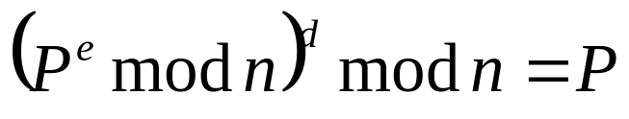
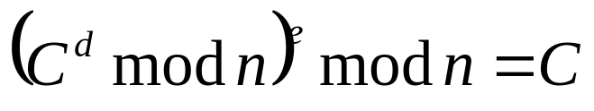

Encryption/Decryption Functions
The encryption function E is defined as
E(e, n, P) = P^{e} mod n
The decryption function D is defined as
D(d, n, C) = C^{d} mod n
So, effectively D and E are the same function!
Problem: need find d, e and n such that:
In other words for any integer m modulo n:
Notes:
We need to find values for “e” and “d” for which this last expression holds for all m modulo n.

Slide 27
4.
RSA Key Selection

Slide 28
Euler Totient Function
Φ(n) (sometimes called the “phi function”) is the number of positive integers less than n which are relatively prime with n.
Example: 4 is relatively prime with 1 and 3, so Φ(4)=2.
If p is prime then Φ(p)=p−1 (since p is relatively prime with any other number less than itself).
Function is “multiplicative”: Φ(x×y)= Φ(x) ×Φ(y)
Therefore if n has prime factors p and q then:
Φ(p×q)= (p − 1)(q − 1)

Slide 29

Euler’s Theorem
Example:
Suppose n=15 and a=7. The numbers 1,2,4,7,8,11,13 and 14 are all relatively prime with 15 so Φ(15)=8. Alternatively 15=5×3 (prime factors) so Φ(15)= Φ(5)×Φ(3)=4×2=8. Now…
You will find this works for any other relatively prime pair. RSA is simply a rearrangement of this formula.

Slide 30
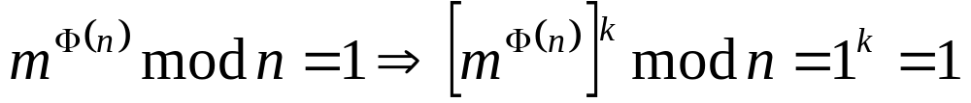

RSA Key Properties
where k is any arbitrary integer.
which is exactly the property we need! All we need therefore is to make:
In other words, we simply need to choose d and e to be modular inverses of each other modulo Φ(n)!
Don’t worry! I will not expect you to remember this proof (or the Euler Theorem either for that matter). I include it here for interest sake.
Notes:
Note that this proof is only valid if m and n are relatively prime, and RSA therefore “ought” not to work if the plaintext P or ciphertext C has a common factor with n. However two points should be noted: (i) If n is the product of primes p and q, only multiples of these values are disqualified, and if large numbers are used these multiples are extremely rare, and unlikely to coincide exactly with C or P. (ii) The RSA algorithm actually *does* still work of P or C has a common factor with n, although it takes a more complicated proof to show why. (This “more complicated” proof – based of Fermat’s Little Theorem - was actually the original proof used by Rivest, Shamir & Adelman, though most modern textbooks give the Euler proof shown on this slide.

Slide 31
RSA Key Generation
  This is the part you do need to remember…
  Choose two prime numbers p and q
  Both p and q should be large (100 digits each)
  Limited sieve followed primality testing. Quite tedious.
Compute
  n = p×q (200+ digits – though quite easy to calculate!)
  N = Φ(p×q) = (p-1)×(q-1) (another very big number!)
Choose e which is relatively prime with N
  Actually this is not too difficult, even with large numbers since relatively prime pairs are quite common.
  Candidate values of e can be tested using the Euclidean Algorithm: if gcd(e,N) = 1 then e must have a multiplicative inverse modulo N
  Calculate d = inverse of e using the extended Euclidean Algorithm
Notes:
You don’t want p and q falling into the wrong hands!!

Slide 32
RSA Key Generation
Remember to “clean up” after yourself…
  Retain n, e and d : these are the ingredients of your public and private keys!
  Destroy p, q and N: these are longer needed and preserving them creates an unnecessary danger!
We assume that plaintext is represented by an integer (or a sequence of integers < n)
  Given plaintext P, we encrypt C = P^{e} mod n
  Given ciphertext C, we decrypt P = C^{d} mod n

Slide 33
5.
Using the RSA Algorithm

Slide 34
Using the RSA Cipher
Needed operation: multiplying/raising to the power of (large) integers modulo (even larger) integer
This may sound hard, but there are some very efficient ways of doing this:
  For example the value to be encrypted can be raised to successive powers of 2, i.e. P×P=P², P²×P²=P⁴, P⁴×P⁴=P⁸… etc.
  Required powers selected in a binary fashion and multiplied
  Example 243²⁷³=243²⁵⁶⁺¹⁶⁺¹=243²⁵⁶×243¹⁶×243
But in this module we will only use “toy examples”

Slide 35
RSA “Toy” Example
Let p = 11 and q = 13
Then n = 11×13 = 143 and N = 10×12 = 120
Choose e = 17 relatively prime to 120
Compute (ext. Euclidean Algorithm): d = 113
  (Check: e×d = 17×113 = 1921 = 1+16×120 = 1 mod 120)
Therefore:
  Encode P by computing C=P¹⁷ mod 143
  Decode C by computing P=C¹¹³ mod 143

Slide 36
RSA “Toy” Example (continued)
How does this work in practice?
Let’s encode the message “PEACE”
We use ASCII for the individual letters
This gives: 80 69 65 67 69
Encrypting: 80¹⁷ 69¹⁷ 65¹⁷ 67¹⁷ 69¹⁷ (mod 143)
Result: 97 75 65 45 75
Decrypting: 97¹¹³ 75¹¹³ 65¹¹³ 45¹¹³ 75¹¹³ (mod 143)
Result: 80 69 65 67 69 (original message!)
In practice we will need a computer to perform computations
Notes:
This is of course vulnerable to letter frequency analysis and similar pattern-based attacks. In practice, individual characters are not encoded in this manner – the next slide shows how encoding/decoding is REALLY done.

Slide 37
RSA Cryptography Standard
Many ways to apply RSA so we need a standard
  Standard dives details about how to encode and sign
  One popular standard is PKCS #1 (v2.1)
For example: to encrypt data D of length |D| octets:
  Need public key (n, e) where n is at least |D| + 11
  Construct a “padding string” PS
    Pseudorandom sequence of n−|D|−3 (typically 8) octets
  Form EB = 00 || 02 || PS || 00 || D
  Convert EB to integer
  Encrypt this using RSA

Slide 38
5.
Cryptanalysis of RSA

Slide 39
Attacks on RSA
Distributed attack:
  Deploy clandestine software to many computers (“botnet”).
  Use combined power of all these machines to factorize n!
Timing attack:
  Attacker measures the decryption time
  This can give clues about what the encryption key was
Key weakness attack:
  p and q should not be too close…
  …or too far apart (small values of d and e are vulnerable)
  Also (p-1) and (q-1) must not have any small factors

Slide 40
Summary
Symmetric and Asymmetric Cryptography
Confidentiality and Authentication
  Digital “signing”
Basics of the RSA Algorithm
  Required properties of RSA keys.
RSA Key Selection
  The Euler Totient Function
  Euler’s Theorem
Using the RSA Algorithm
Cryptanalysis of RSA

Slide 41
Homework
Next time we will start to consider cryptographic “hash functions”
  Watch the following YouTube video:
    https://www.youtube.com/watch?v=b4b8ktEV4Bg
  Google “hash function” and based on your findings:
    Make a list of the properties a good hash function will have
    List some popular hash function algorithms and make a note of their properties
    List some of the things hash functions are used for

